Slide 1
Big Data Project Spam Filtering using Naïve Bayes
COEN 242 – Winter2015
Group 4
Ajay Videkar (W1111605)
Harsha Teja Kanikicherla (W1071900)
Harshkumar Pandya (W1114569)
Jillian Carleton (W0355725)
Lakshitha Raj Vasanadu (W1115006)
Pratham Vasa (W1136169)
Seema Sardesai (W1008598)
Shrividya Manmohan (W1026992)
Spandana Namburu (W1060542)
Srinivas Reddy (W1136100)

Slide 2
Agenda
Introduction
Weka Performance Analysis
Mahout Performance Analysis
Hadoop MapReduce Framework
Conclusion

Slide 3
Introduction
Problem Description
Enron E-mail Dataset
Naive Bayes Overview
Data Cleaning
Training and Testing Dataset

Slide 4



Introduction
GOAL
Performance analysis between machine learning tools such as Weka, Apache Mahout and our own Implementation of MapReduce over Hadoop for Big Data
PROBLEM DESCRIPTION
Email Classification as Spam or Ham
Performance comparision of Weka, Mahout and Hadoop
ALGORITHM USED
Supervised Learning Technique using Naive Bayes Classifier

Slide 5


ENRON E-mail Dataset
The Enron Email Dataset consists of emails of the Enron company employees
Enron was the world's leading energy company that went bankrupt
The dataset contains 517431 messages organized into 150 folders, resulting in 16.8GB of data
Each folder contains sub folders - inbox, sent, discussion_threads, all_documents, deleted_items. Data Reduction was performed to obtain only the Inbox
Each message consists of the header fields - Message_ID, To, From, Subject, Date and the Content
Dataset consists of both Spam and Ham messages enabling Spam filtering
Sample email message:
Date: Fri, 2 Nov 2001 12:18:31 -0800 (PST)
From: renee.ratcliff@enron.com
To: k..allen@enron.com
Subject: RE:
Phillip,
<Email Content>
Thanks,
Renee

Slide 6
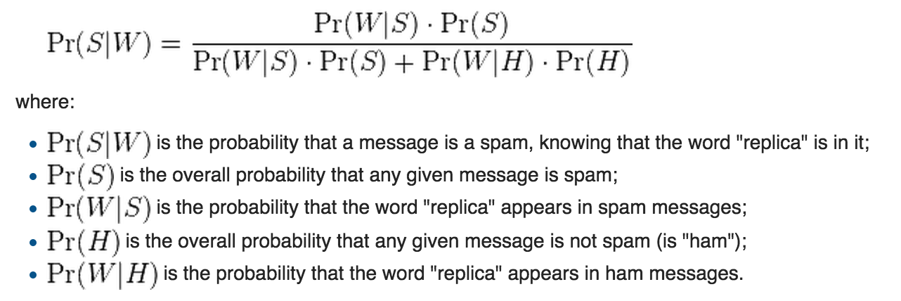
Naïve Bayes Overview (1 of 2)
What is Naïve Bayes?
Class of Probabilistic Classifiers under Supervised Learning Technique
Builds models that assign class labels to problem instances, represented as vectors of feature values
Uses the method of maximum likelihood
Computing the probability that a message containing a given word is spam vs. ham involves conditional probability

Slide 7

Naïve Bayes Overview (2 of 2)
Why Naïve Bayes?
Naive Bayes Text Classifiers are fast, accurate, simple and easy to implement
Simple to implement: No numerical optimization, no matrix algebra, etc.
Efficient to train and use: fitting and updating of data
Independence: allows parameters to be tested on different datasets
Uses Generative model: Unlabeled data can be used in parameter estimation

Slide 8
Prep-work: Data Cleaning
Identified 156 Enron employees from 150 folders
Removed special characters
For Mahout
Java Code
Mapped optional names and multiple email IDs for each employee
Added attributes TO and FROM, subject and body to the unstructured emails
The email folders in .pst format (MS Outlook) were converted to .txt format (text)
Python Code
Removed duplicate emails
Break down e-mail chain to separate emails
Java Code
convert .txt files to.csv
Selected emails among these 156 employees from the whole dataset
For Weka
Weka Tool
Convert the .csv files to .arff format

Slide 9


Prep-work: Training Set & Testing Set
Separating data into training and testing sets is an important part of evaluating data mining models
Typically, in this process, most of the data is used for training, and a smaller portion of the data is used for testing
Training set is implemented to build up a model, while a test (or validation) set is to validate the model built
For Weka
80% training set
20% testing set
For Mahout
80% training set
20% testing set

Slide 10
Weka Performance Analysis

Slide 11
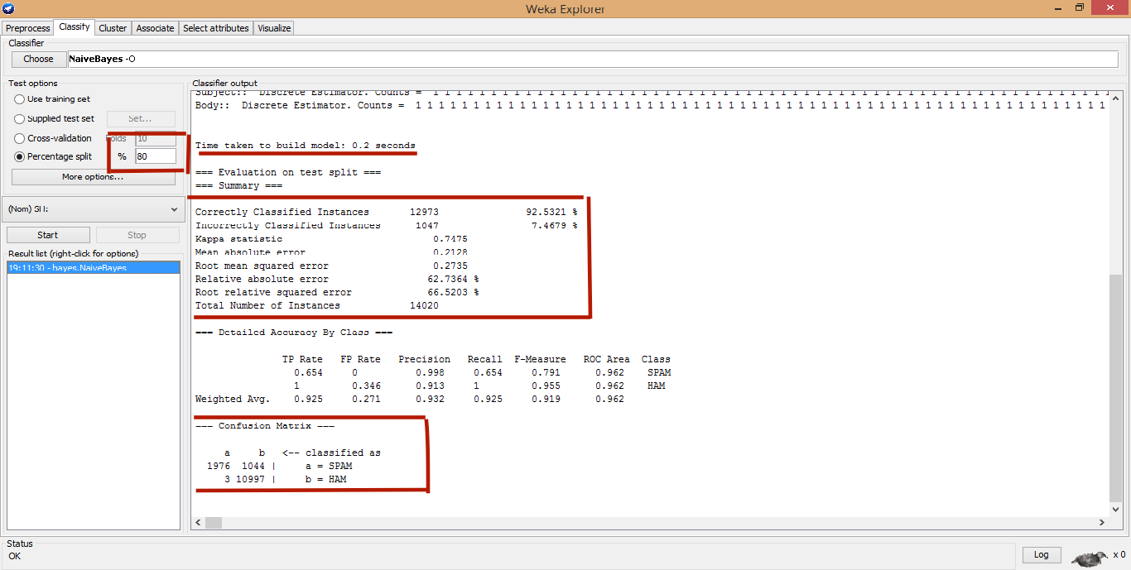
Weka Analysis Snapshot

Slide 12
Mahout Performance Analysis

Slide 13
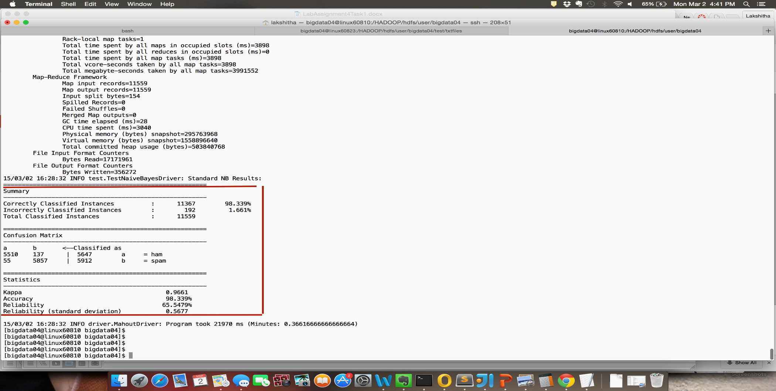
Mahout Analysis Snapshot

Slide 14
Hadoop MapReduce Framework

Slide 15


Hadoop Implementation
Divided the dataset into training and testing data using python script
Implemented MapReduce to get the InvertedIndex of each word for spam and ham emails separately
Implemented the Naïve Bayes algorithm

Slide 16
Conclusion
Results
Comparison on different datasets
Conclusion

Slide 17
Results for Small Dataset
Data size(in Mb) | WEKA (sec) | Mahout(sec) | Weka (%) | Mahout (%) | Hadoop (min) | Hadoop (%)
30 | 0.05 | 91.831 | 92.53 | 98.41 | - | -
50 | 0.2 | 92.322 | 91.2 | 98.93 | 10.3 | 91
70 | 4 | 95.989 | 91.5 | 98.69 | - | -
100 | 22 | 96.78 | 92.3 | 98.73 | 11.01 | 92.3
150 | 56 | 115.64 | 91.1 | 98.89 | - | -
200 | 101 | 130.02 | 90.5 | 98.95 | - | -
300 | 178.65 | 150.76 | 92.1 | 98.73 | - | -
500 | 269 | 172.67 | 92.3 | 98.37 | 14 | 91.5

Slide 18
Results for Big Dataset
Data size(in Mb) | WEKA(sec) | Mahout(sec) | Weka (%) | Mahout (%) | Hadoop (min) | Hadoop(%)
750 | 347 | 187.51 | 89.6 | 98.43 | 18 | 90.67
1000 | 715 | 195.28 | 88.7 | 98.12 | 32 | 90.4
1200 | 904 | 210.46 | 88.5 | 97.9 | - | -
1500 | - | 225.3 | - | 98.1 | 42 | 91.1
2000 | - | 234.78 | - | 98.13 | 54 | 90.7

Slide 19
Comparison: Mahout vs WEKA (Small Dataset)
Time (sec)
Weka
Dataset size in MB

Slide 20
Comparison: Performance of Mahout for different Dataset Sizes
Time(sec)
Dataset size in MB

Slide 21
Comparison: Mahout vs Hadoop (implemented) for different Dataset Sizes
Time (sec)
Dataset size in MB

Slide 22
Conclusion
We observed that WEKA performs better than Mahout/Hadoop for small size datasets (till about 200Mb)
For medium and large dataset sizes, Mahout/Hadoop performs better than WEKA
This is because the setup time taken by Mahout/Hadoop to run a job is very long
We observed that the build time of WEKA increases exponentially as we increased the dataset size while Mahout/Hadoop shows a linear increase

Slide 23
Thank you!

Slide 24

Questions

Slide 25
Appendix

Slide 26
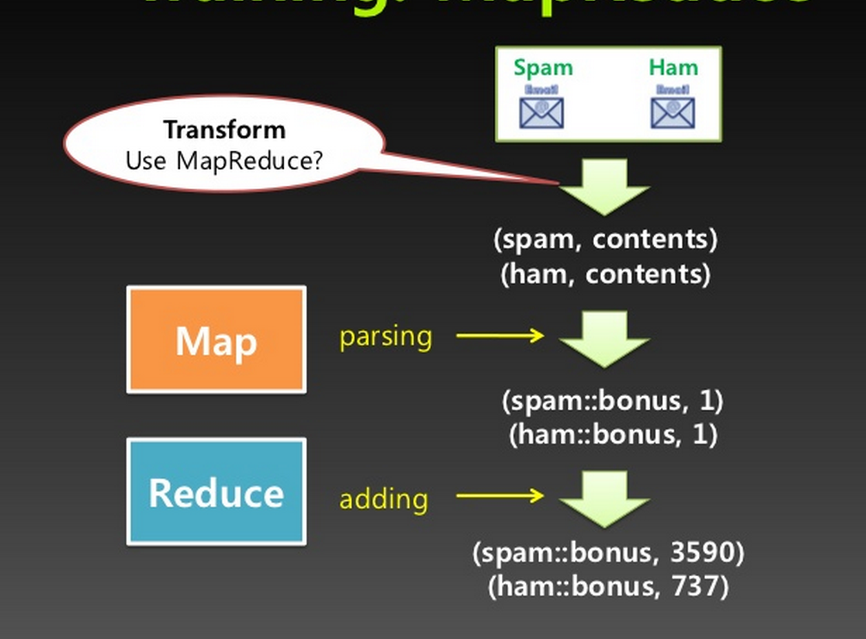
MapReduce Model Illustration

Slide 27
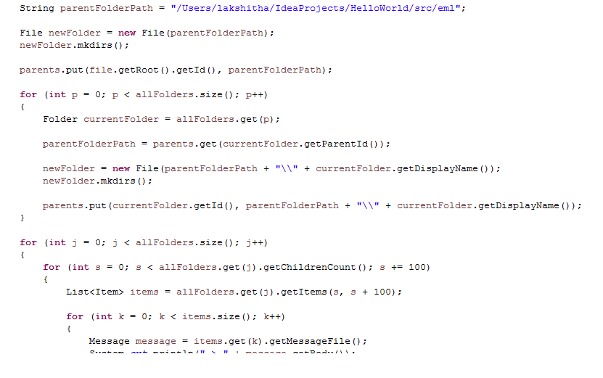
Code for Data Cleaning (1 of 2)
.pst to .txt conversion

Slide 28


Code for Data Cleaning (2 of 2)
Breaking Text Files
.txt to .csv conversion

Slide 29
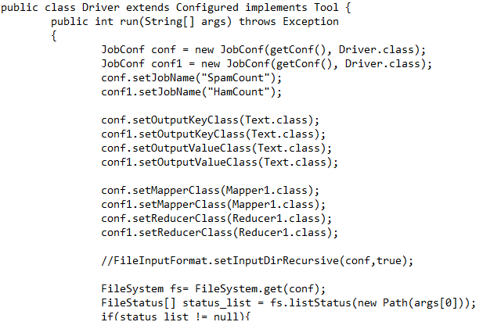
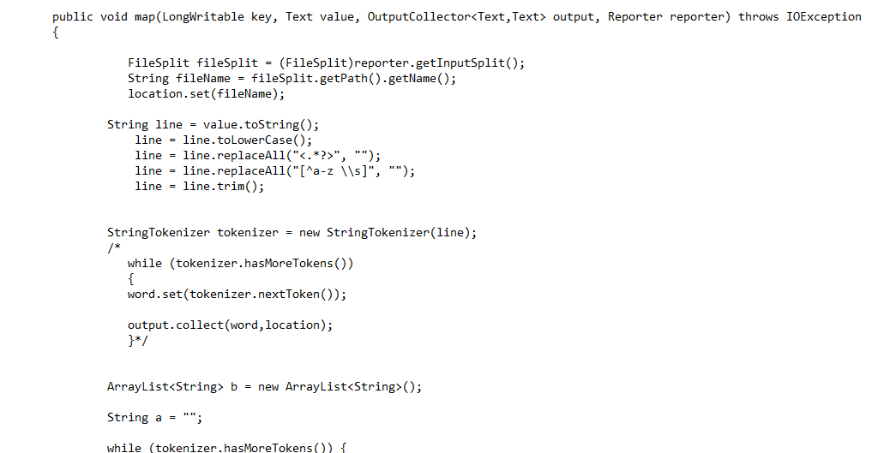
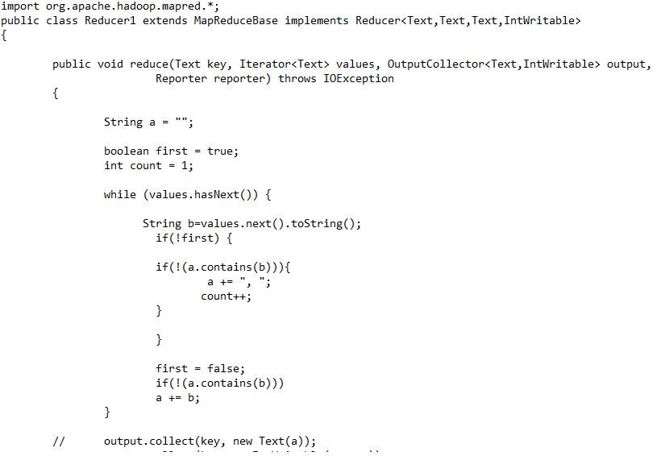
Code for MapReduce
Mapper.java
Driver.java
Reducer.java

Slide 30
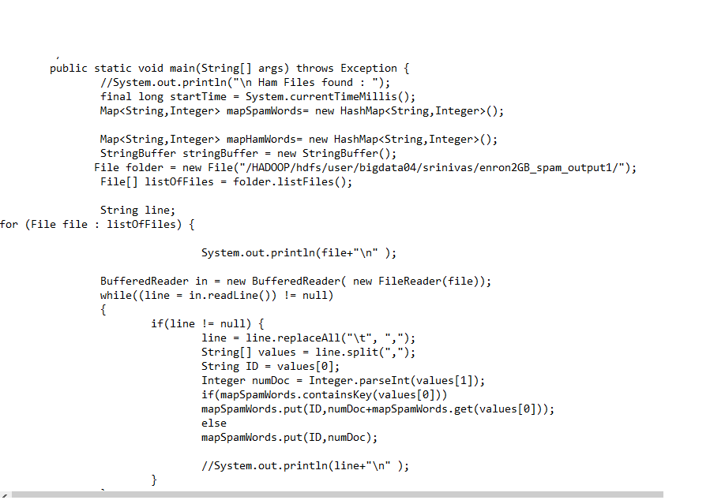
Naïve Bayes Implementation

Slide 31

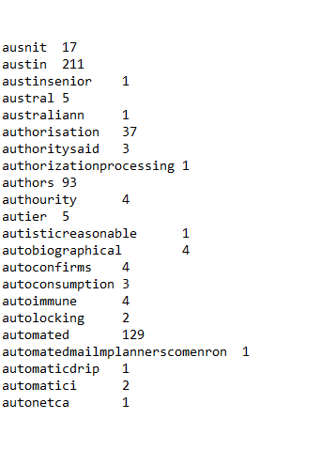
Output
Ham Inverted Index Output
Spam Inverted Index Output

Slide 32
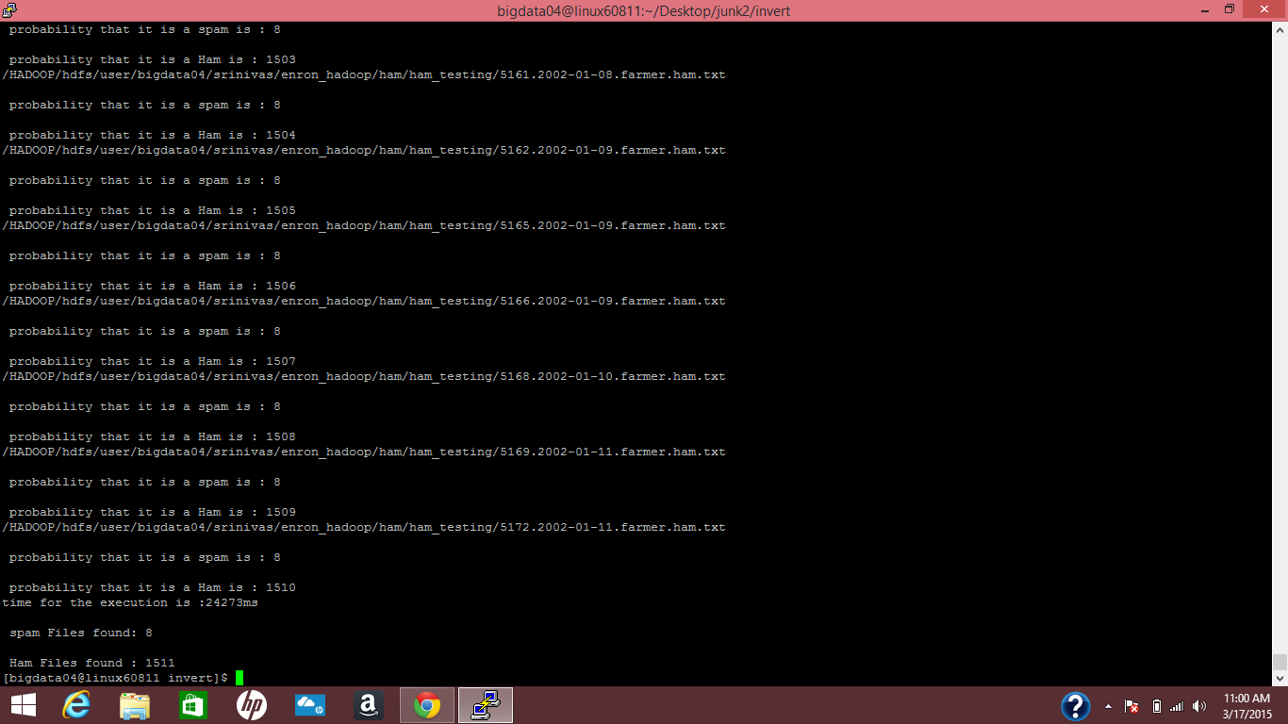
Output
Naïve Bayes Output

